Slide 1

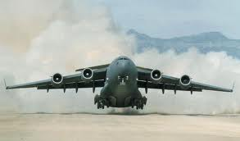
Implementation Of The SBAR Checklist To Improve Patient Safety In USAF Aeromedical Evacuation
Capt. Dana Adrian, Lt Col(s) Karey Dufour, Capt. Scott Holcomb,
Maj. Don Potter, & Mr. Collins Uzuegbu
Wright State University CoNH
23 May 2011
Notes:
SBAR – Situation – Background – Assessment – Recommendation
USAF – United States Air Force

Slide 2
Team Members
USAFSAM Nurse Researcher For Enroute Care
  Lt Col (s) (Dr.) Sue Dukes
Expert Flight Nurse & Primary Investigator
  Lt Col (s) Karey Dufour
WSU/AFIT
  Maj. Don Potter, Capt. Dana Adrian, Capt. Scott Holcomb, & Mr. Collins Uzuegbu
Other Support
  Col (Dr.) Liz Bridges, Dr. Lori Loan, Dr. Tracy Brewer

Slide 3
Overview
Problem Identification
PICOT Question
ROL & Strength Of Evidence
Action Plan Summary
Recommendations For Practice
Pilot Study
Conclusion
Notes:
ROL – Review of Literature

Slide 4

Problem Identification
Overview Of Problem
  Ineffective, Inadequate, Absent Communication
  Poor Handoff Communication = Decreased Patient Safety
  Problem Worse In Volatile Environment
Background/Significance
  Communication Improved With Standardized Checklist
  Lack Of Checklist In Aeromedical Evacuation (AE)
  Patient Handoff Incidents Doubled From 2009
  One Handoff Checklist Can Affect Top 3 Problem Areas
Notes:
Inadequate communication is a problem in the hospital where the environment is relatively controlled. It is worse in the complex environment of battle.
A standardized checklist eliminated missing information and promoted the sharing of information.
There is no standardized checklist in AE.
In 2010, 1,894 PMQ-R submissions made covering 28,227 patients.
Patient handoff incidents (inadequate/absent handoffs) doubled from 65 in 2009 to 130 in 2010.
Top 3 issues noted from the data collected: patient preparation, patient handoff, medication errors.
Standardized checklist could potentially affect all 3 areas.
In aviation, standardized checklists optimize safety by reducing omissions.
Crew resource management highly recommends checklist use because it helps prioritize, recall information, and reinforce a positive approach toward safety.

Slide 5

PICOT Question:
In Air Force Flight Nurses Transporting Patients In The Aeromedical Evacuation System (P), Does The Use Of A Standardized Patient Handoff Checklist (Using The SBAR Method) (I), Compared To Current Patient Handoff Practices (C), Improve Patient Safety As Measured By Incident Reports (O) Over The Course Of Six Months (T)?

Slide 6
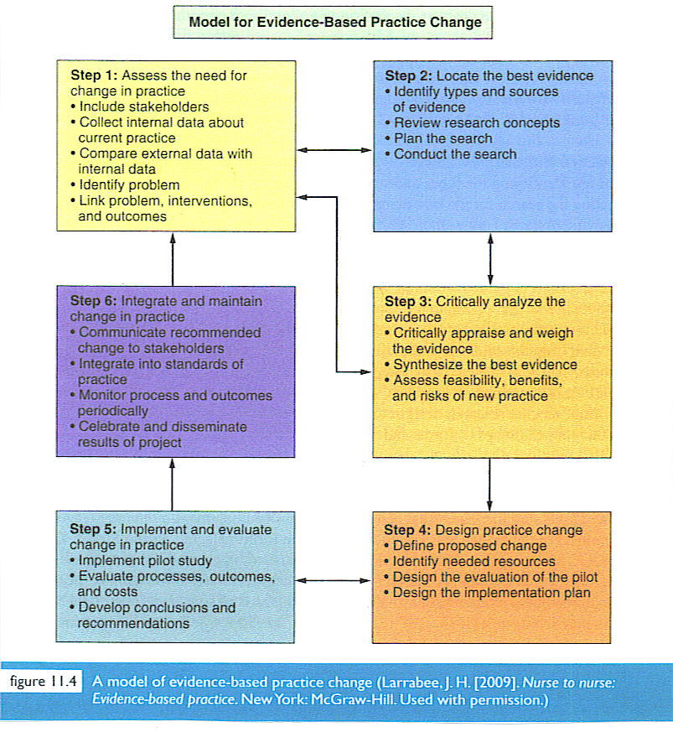
Conceptual Framework
Notes:
70% of all major changes in organizations fail because they do not take a holistic approach to see the change through. This model improves their ability to change, increasing their chances of success to adapt continuously.

Slide 7
Synthesis Table

Slide 8

Review Of Literature
Type Of Literature
8 Articles
  1 Randomized Control Trial (Level II)
  1 Quasi-Experimental Without Randomization (Level III)
  4 Systematic Reviews Of Literature (Level V)
  2 Single Descriptive Or Qualitative Studies (Level VI)
Strength Of Evidence = Level Of Evidence + Quality Of Evidence

Slide 9

Review Of Literature
Quality And Strength Of Evidence
  Articles Showed Overwhelming Positive Outcomes Using A Standardized Format, Especially SBAR
  Standardized Handoff Tool Most Likely To Improve Communication And Patient Care
  Significant Gaps For Standardized Patient Handoff Checklist In AE Arena
  Many Articles Discussed SBAR
    Only Two Had Actual Data Collection
    Cited Education Piece Required
    Lack Of Data Denotes Research Need
Notes:
AE – Aeromedical Evacuation

Slide 10
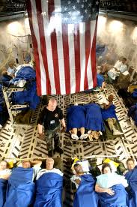
Action Plan Summary
Population/Sample
Protection Of Human Subjects
Team Members
Stakeholders
Identification Of Key
Barriers & Facilitators

Slide 11
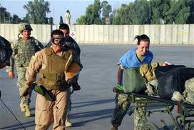

Population/Sample
AD, Guard, & Reserve Flight Nurses
USAF Aeromedical Evacuation Missions
Inter-Service Communication
Possibly Expand To
CCATT Missions
Notes:
AD – Active Duty
CCATT – Critical Care Air Transport Team

Slide 12

Protection Of Human Subjects
CITI Certificates
IRB Process
Voluntary Participation
  Military-Specific Concerns
  Perception Of Coercion

Slide 13
Team Members
USAFSAM Nurse Researcher For Enroute Care
  Lt Col (s) (Dr.) Sue Dukes
Expert Flight Nurse & Primary Investigator
  Lt Col (s) Karey Dufour
WSU/AFIT Students
  Maj Don Potter, Capt Dana Adrian, Capt Scott Holcomb, & Mr. Collins Uzuegbu
Other Support
  Col (Dr.) Liz Bridges, Dr. Lori Loan, Dr. Tracy Brewer

Slide 14

Stakeholders
USAF AD, Guard, & Reserve Flight Nurses
Aeromedical Staging Facility Personnel
HQ AMC Patient Safety Division Personnel
Notes:
AD – Active Duty
HQ AMC – Headquarters Air Mobility Command

Slide 15


Barriers & Facilitators
Perceived Increased WL
Established Processes
Concern Of Redundancy
  Pencil-Whipping Effect
AE Crew Support
Command Support
Notes:
WL – Workload
AE – Aeromedical Evacation

Slide 16
SBAR Tool
Originally Created Using Five Examples
CVI Performed By Panel Of Eight Experts
  Checklist Calculated At 80%...........Goal Was 85%
  Outliers & Workload Concerns
  Recalculation = 88%
Modifications Made Per Recommendations
Inter-rater Reliability Assessed During Pilot
Notes:
CVI – Content Validity Index

Slide 17

SBAR Tool
Situation–Background–Assessment–Recommendation
Standardized Checklist For Handoff
Used In Multiple Areas
Has Not Yet Been Applied To AE
TJC National Patient Safety Goal

Slide 18
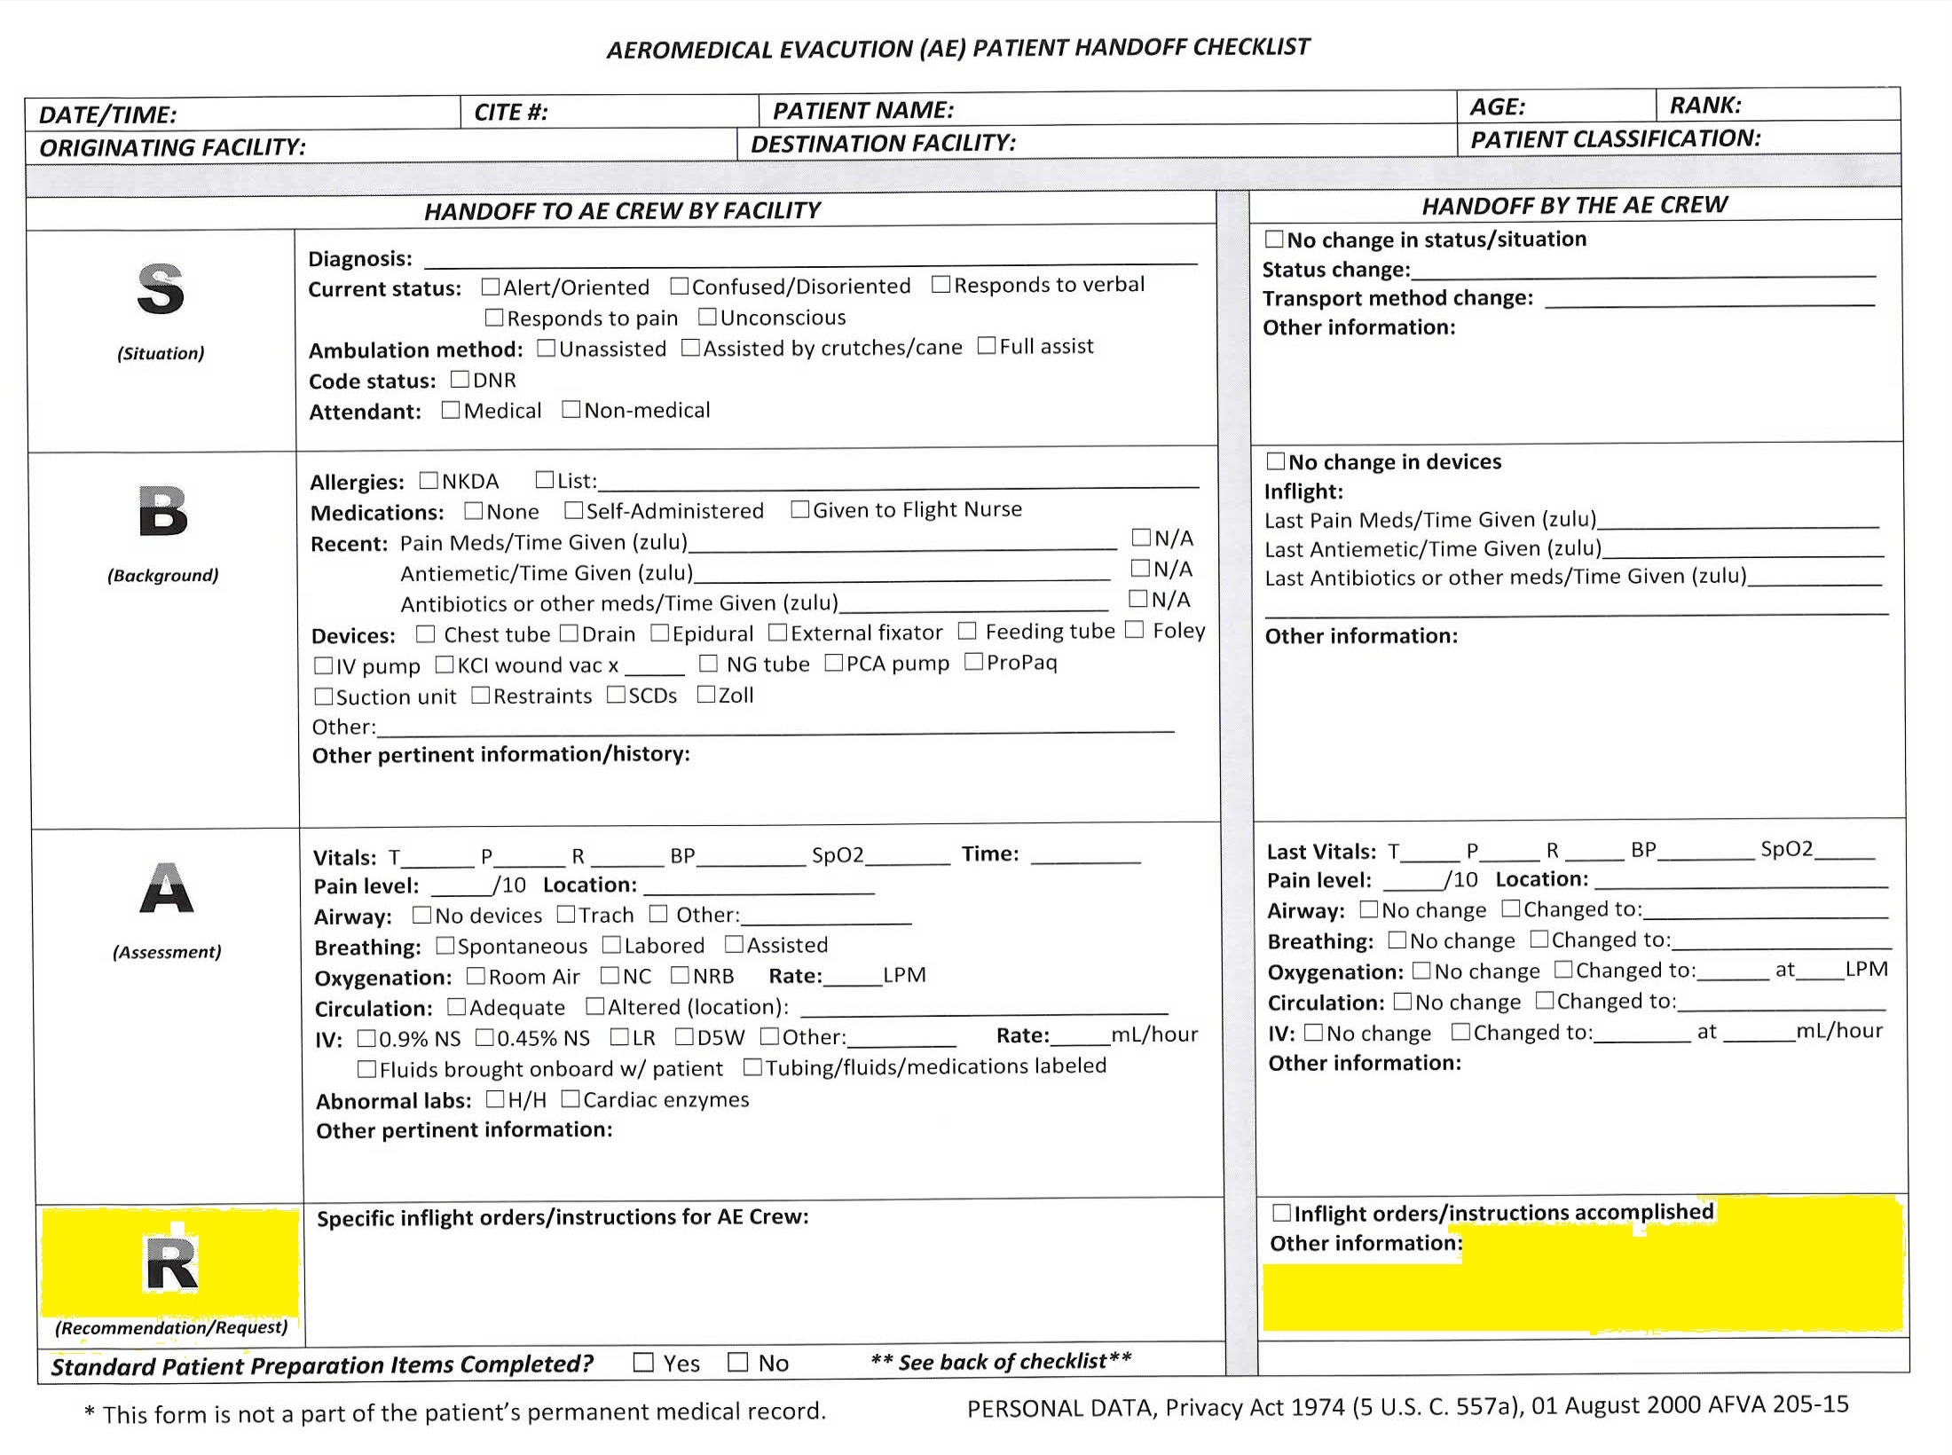

Slide 19
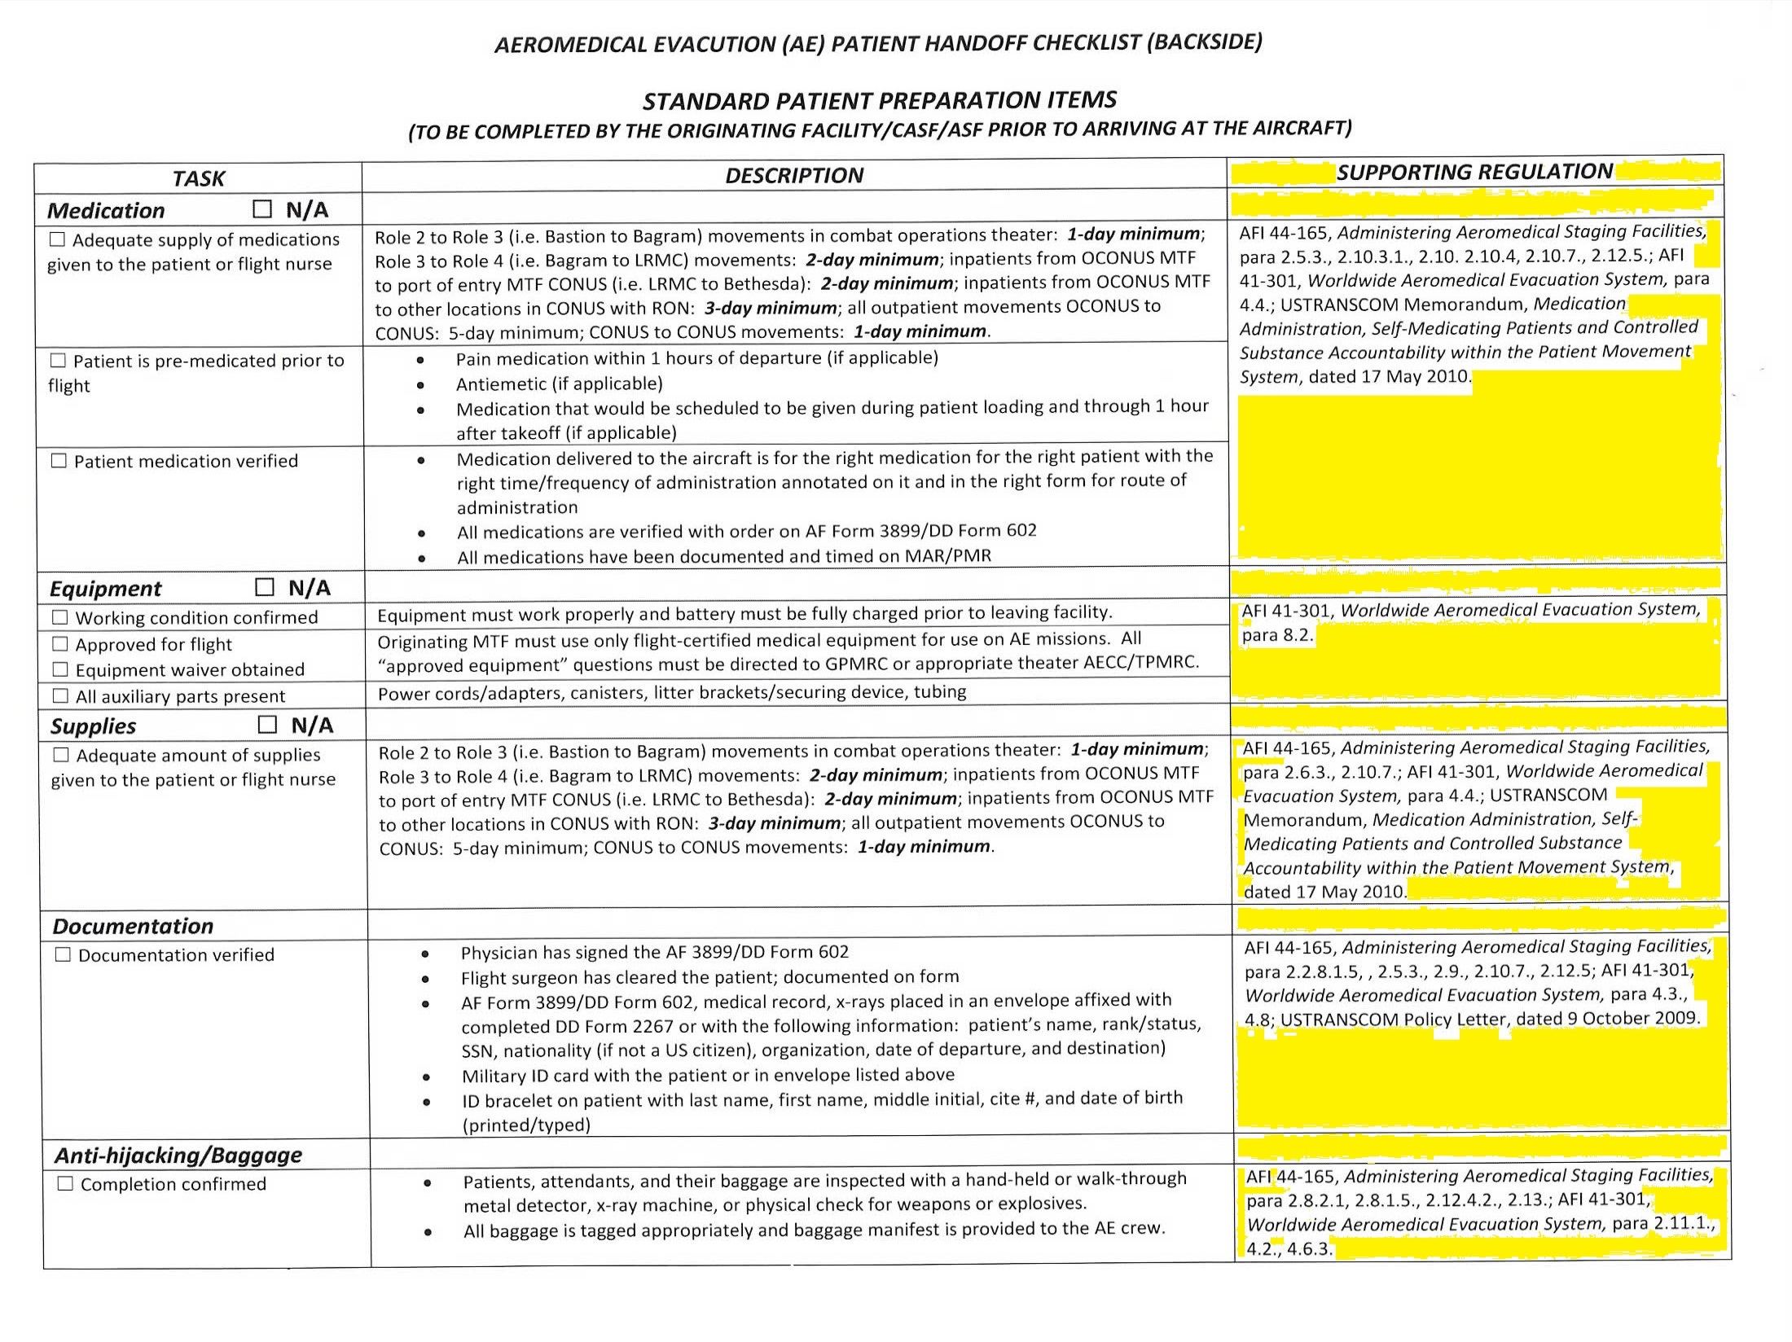

Slide 20
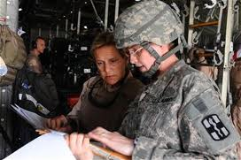
Recommendations For Practice
Evidence Supports Communication Problems Are Improved With Written Checklists
  MUST Have Standardized Educational Piece
In Collaboration With…
  Leadership (HQ AMC, AE Squadron Commanders)
  Stakeholders (AE & CASF Nurses)
HQ AMC – June 2011
RODEO – July 2011
AMSUS – Nov 2011
Notes:
RODEO – Actual Name
AMSUS - Association Of Military Surgeons Of The United States

Slide 21

Budget
Grant $$ Received
Minimal Cost For Pilot
  Communication Via Phone/Internet
  Copying Costs Absorbed
Dissemination/TDY Costs
  Original Plan – Travel For Collaboration
  Current Plan – RODEO & AMSUS
Notes:
TDY – Temporary Duty

Slide 22
Pilot Study
Use Of SBAR Tool During Already Planned Military Training Event On 11 May 2011
USAF Flight Nurses & CASF Nurses
Prep Work – Patient Packets, Masters, & Script
Ethical Considerations
Pre-Brief/Out-Brief & Survey
Notes:
CASF – Contingency Aeromedical Staging Facility

Slide 23

Pilot Study - Results
Overall Positive Feedback & Support
  Recommended Changes To Tool Will Be Evaluated
True Time Hack Vs. Perceived Time Spent
  Received Education But Lacked Practice With Tool
Nursing Report
Accuracy Of Data Points
Notes:
Nursing Report – meaning too loud for verbal communication during exercise so they pointed to form…

Slide 24
Conclusion
Problem Identification
PICOT Question
ROL & Strength of Evidence
Action Plan Summary
Recommendations For Practice
Pilot Study
Conclusion

Slide 25
References
Arora, V. M., Manarrez, E., Dressler, D. D., Basaviah, P., Halasyamani, I., & Kripalani, S. (2009). Hospitalist handoff: A systematic review of task force recommendations. Journal of Hospital Medicine, 4(7), 433-440. doi:10.1002/jhm.573
Beckett, C. D., & Kipnis, G. (2009). Collaborative communication: Integrating SBAR to improve quality/patient safety outcomes. Journal for Healthcare Quality, 31(5), 19-28.
Behara, R., Wears, R. L., Perry, S. J., Einsenberg, E., Murphy, L., Vanderhoef, M., Shapiro, M.,...Cosby, K. (2005). A conceptual framework for studying the safety of transitions in emergency care. In K. Henriksen, J. B. Battles, E. S. Marks, & D. I. Lewin (Eds.), Advances in patient safety: From research to implementation (Vol. 2, pp. 309-321). Retrieved from http://www.ahrq.gov/downloads/pub/advances/vol2/Behara.pdf
Endsley, M. R. (2000). Theoretical underpinnings of situation awareness: A critical review. In M. R. Endsley & D. J. Garland (Eds.), Situation awareness analysis and measurement (pp. 1-24). Mahwah, NJ: Lawrence Erlbaum Associates.
Melnyk, B. M. & Fineout-Overholt, E. (Eds.). (2011). Evidence-based practice in nursing & healthcare: A guide to best practice (2nd ed.). Philadelphia: Lippincott, Williams, & Wilkins.
MacDonald, R. D., Banks, B. A., & Morrison, M. (2008). Epidemiology of adverse events in air medical transport. Academy of Emergency Medicine, 15(10), 923-931. doi:10.1111/j.1553-2712.2008.00241.x
Marshall, S., Harrison, J., & Flanagan, B. (2009). teaching of a structured tool improves the clarity and content of interprofessional clinical communication. Quality & Safety in Health Care, 18, 137-140.
Miller, K., Riley, W., & Davis, S. (2009). Identifying key nursing and team behaviours to achieve high reliability. Journal of Nursing Management, 17, 247-255.
Pothier, D., Monteiro, P., Mooktiar, M., & Shaw, A. (2005). Pilot study to show the loss of important data in nursing handover. British Journal of Nursing, 14(20), 1090-1093.
Riesenberg, L. A., Lietzsch, J., & Cunningham, J. M. (2010). Nursing handoffs: A systematic review of literature. AJN, 110(4), 24-34.
Riesenberg, L. A., Leitzsch, J., & Little, B. W. (2009). Systematic review of handoff mnemonics literature. American Journal of Medical Quality, 24(3), 196-204. doi:10.1177/1062860609332512

Slide 26
Contact Information
Lt Col (s) Karey Dufour affn98@gmail.com
Maj Don Potter potter.39@wright.edu
Capt Dana Adrian adrian.8@wright.edu
Capt Scott Holcomb holcomb.13@wright.edu
Mr. Collins Uzuegbu uzuegbu.2@wright.edu

